Slide 1
#letapecanada

Slide 2
Contents
1
Welcome Letter
Welcome from the Executive Director
The Tour de France
L’Étape by Tour de France Race Series Tour de France History
Iconic Jerseys
Ambassador - Alberto Contador
L’Étape Edmonton Expo
Event Schedule
Packet Pick Up
Race Swag
Classe Spéciale Travel
The Route
Course Information
Long route Route & GPS Download
Medium route Route & GPS Download
Short route Route & GPS Download Safety Vehicles & Course Markings 16
Awards & Prizes 17
FinisherPix 18
The Ride Race Day Details 19
FAQ 20-21
Water Stations 21
Race Rules 22-23
Call for Volunteers 24
Explore Edmonton 25-28
2
3
4
5
6
7
8
9
10
11
12
13
14
15
Located in Treaty 6 Territory - Amiskwacîwâskahikan ᐊᒥᐢᑲᐧᒋᐋᐧᐢᑲᐦᐃᑲᐣ and Métis Region 4

Slide 3
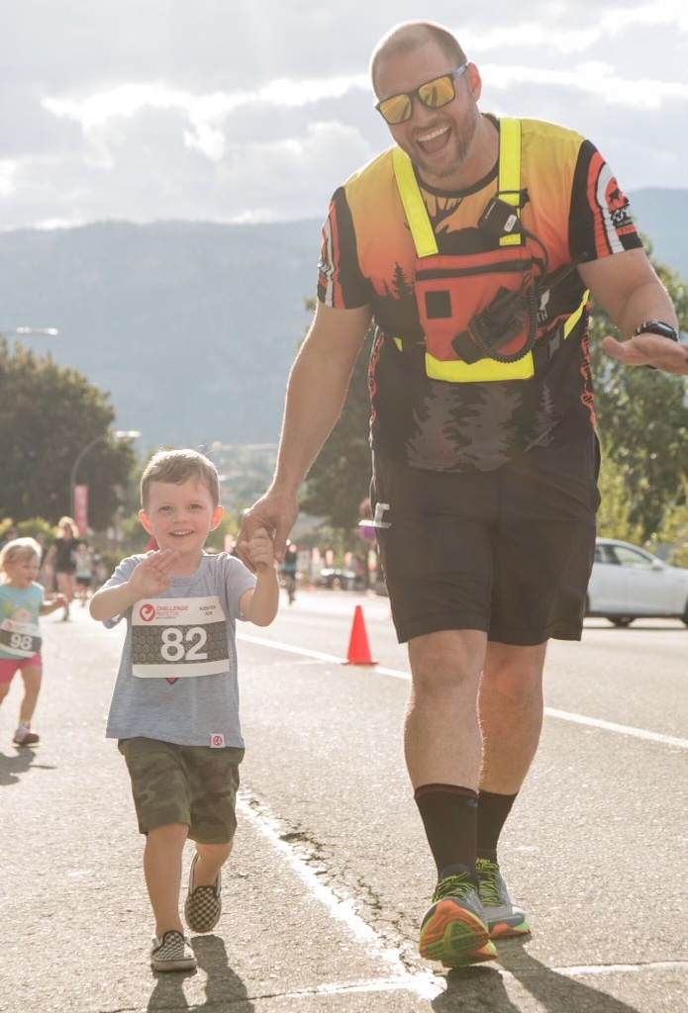
Welcome from our Executive Director
Hello and welcome to L’Étape Edmonton by Tour de France. Edmonton is one of the most beautiful and welcoming cities in Canada and we are happy and honoured to bring the first edition of L’Étape by Tour de France to its streets.
Athletes—you are in for an amazing weekend. Our team has been working for over a year to ensure a safe, fun, and memorable event. Volunteers—thank you! Without you, the event doesn’t happen, and we are grateful for your participation.
I would personally like to thank Explore Edmonton and the city of Edmonton and their teams for their unwavering support from day one. Their commitment to the success of the event cannot be overlooked and this has been a team effort to produce one of the greatest cycling events Canada has ever seen.
2
I’d also like to thank, Parkland county, and of course the amazing city of Edmonton and all its residents for allowing L’Étape Edmonton into their communities and on their roadways. And to our sponsors—thank you for your incredible contributions and support for this event
Whomever wears the Yellow Jersey at the end of the day will live with the Tour de France legends. Go out and ride hard, have fun, and most of all take care of your fellow cyclists out there.
Be safe and have an amazing day!
Michael Brown
Executive Director
MB Events
Notes:
New letter from Michael

Slide 4
3

Slide 5
Tour de France History
4

Slide 6
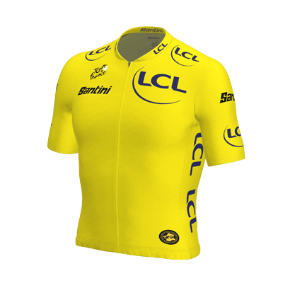
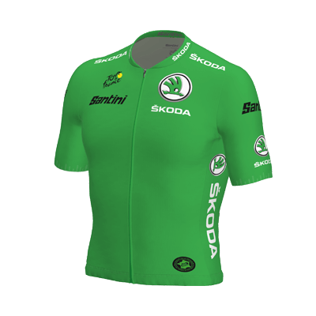
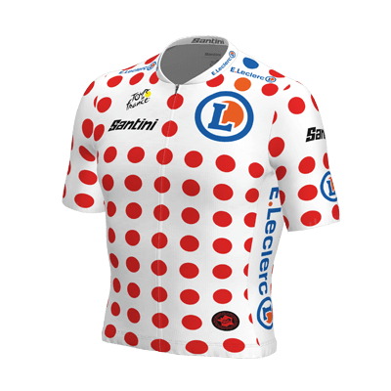
Tour de France Jerseys
5
The symbol of the Tour de France—the Yellow Jersey. At the Tour de France this goes to the first across the finish line at the end of every stage and to the overall winner on the Champs-Élysées. At L’Étape Edmonton by Tour de France, the top overall female and male finishers will win the iconic Yellow Jersey!
The Green Jersey represents explosivity, passion, and speed, typically going to Tour de France sprinters. At L’Étape Edmonton, the Green Jersey goes to the top three male and female sprinters. Fastest through the timed sprint section wins the Green Jersey!
The symbol of the mountains, of a rider pushing beyond their limits and of courage—the Polka Dot Jersey! This jersey is awarded to the Tour de France’s leader of the best climber classification. At L’Étape Edmonton,this goes to the King of the Mountain and the Queen of the Mountain. The three overall strongest climbers through the timed-climb section will be awarded the Polka-Dot Jersey.

Slide 7
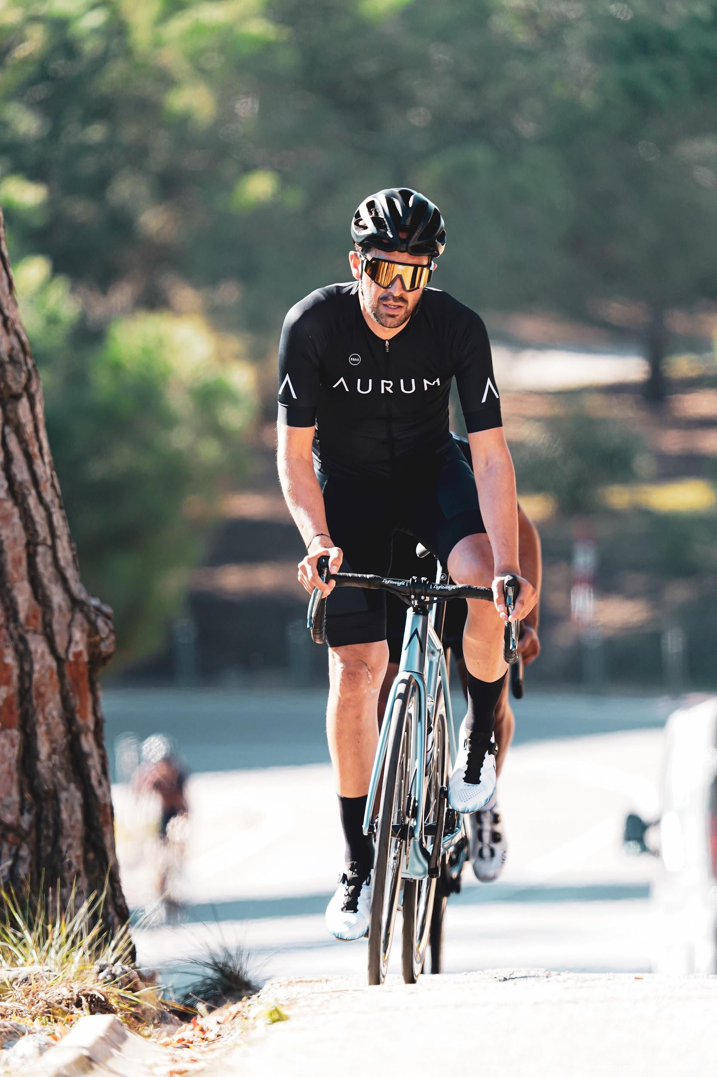
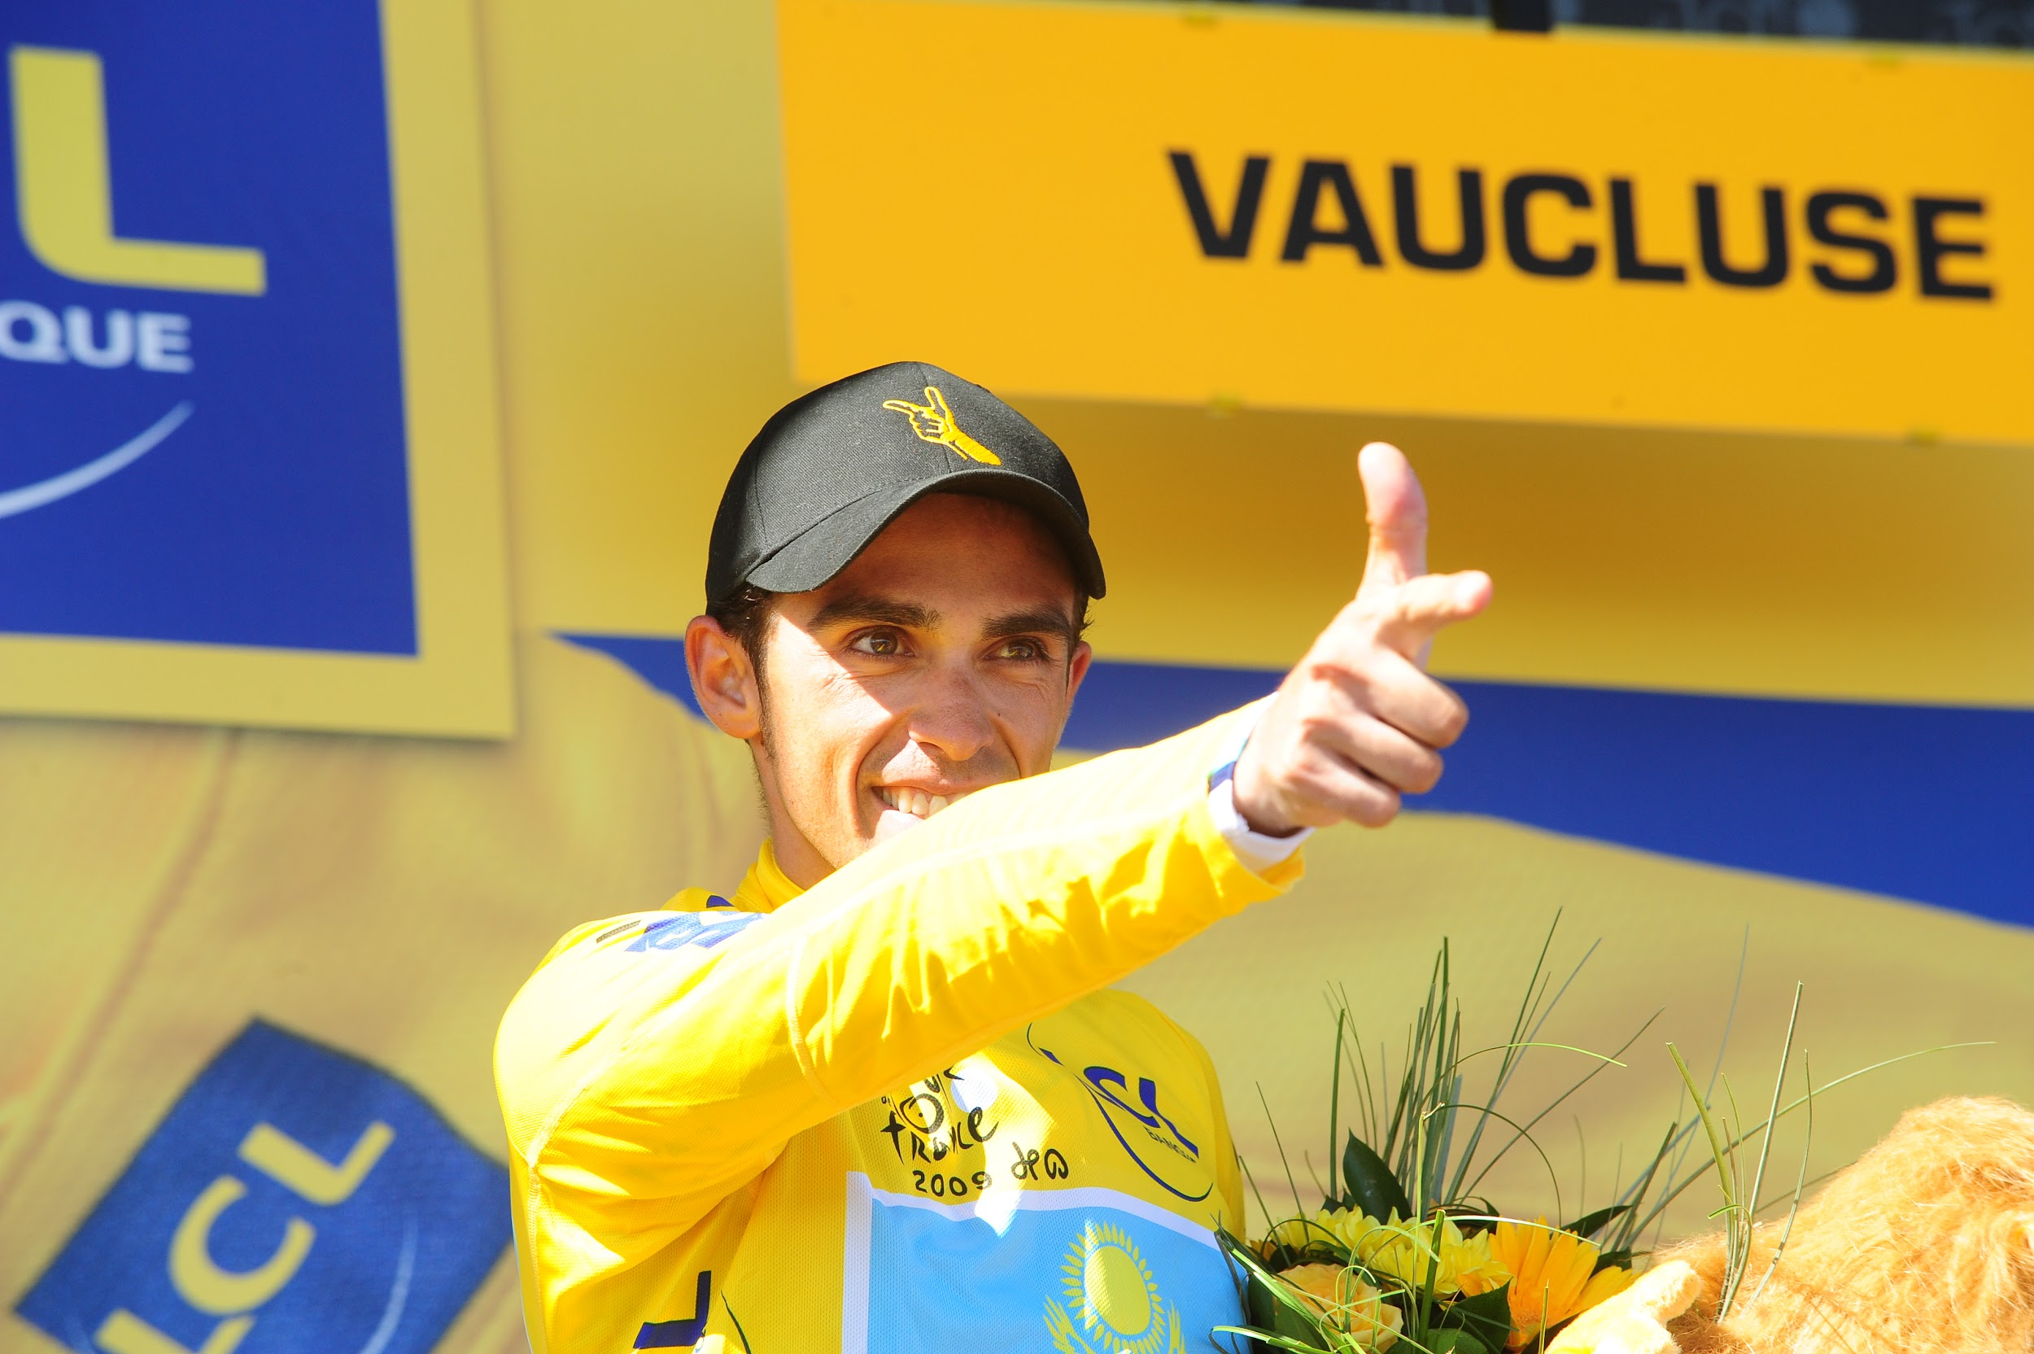
Alberto Contador
6
9
Two-time Tour de France Champion Alberto Contador is coming to Edmonton! One of the most decorated professional cyclists of all time Alberto Contador is coming to Edmonton, Edmonton, for the first-ever L’Étape Edmonton by Tour de France. Contador is set to be the official Tour de France Ambassador at this new, mass participation cycling event.
The Spanish cyclist, two-time Tour de France and Giro d’Italia winner, and three-time Vuelta a España winner will be part of the entire L’Étape Edmonton weekend. Contador will offer insights into his most competitive races at the Champions Dinner and will be available for meet and greets. He will also take part in the main race on Sunday.

Slide 8
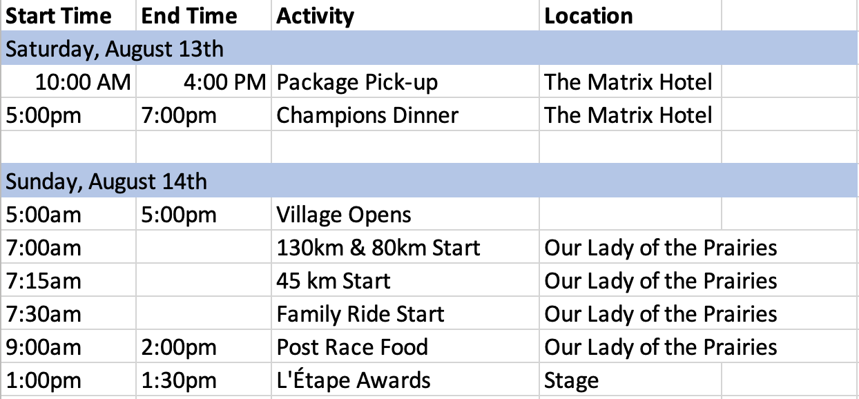
7
Schedule

Slide 9
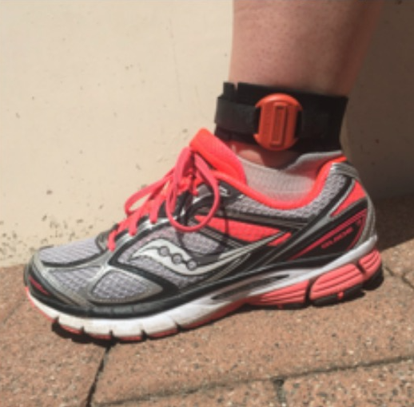
Packet Pick Up
8
What you will receive
T-shirt
Swag (See Race Swag page pg .)
Athlete Kit (Bib, Timing Chip)
Wristband
*Finishers Medal
*Finishers medal will be handed out after the finish line
Packet pick up location
Matrix Hotel 10640 100 Ave
Saturday August, 13th
Time: 10:00am- 4:00 PM
NOTE: Bib pick up: You will be required to show your photo ID at Packet Pick Up. Please have it with you and ready to show the volunteers and staff in order to collect your packet.
Race Packets are assigned based on the distance chosen at registration and your start corral is assigned based on the answer to the average speed question during registration. Your wave will be assigned to you in your race packet and will not be available in advance.
Changes to your registration, including changing distances, should be done prior to the event weekend by emailing info@mbevents.ca
Timing Chip
This is a chip-timed race! You will receive a timing chip during packet pickup that MUST be attached to your left ankle. See image >
Notes:
Saturday 10-4 @ Matrix headquarters hotel

Slide 10
Race Swag
Road closures:
9
Showcase your epic achievement! Swag items are included with registration and you’ll get them at packet pickup.
Notes:
Complete swag bag/ change to what we are offering. Need pics*

Slide 11
Classe Spéciale
10
Experience the L'Étape by Tour de France VVIP Experience
The Classe Spéciale category is limited to
only 250 riders and includes big perks,
goodies and unforgettable experiences.
You can race in any distance with
Classe Spéciale.
The Classe Spéciale category features:
Full 2022 L'Étape Edmonton by Tour de France cycling kit
Fast-lane pick-up of your L'Étape Edmonton by Tour de France race package during the event.
VIP race staging area, including easy-access to your preferred start staging area and pre-race food and beverage for L'Étape Edmonton.
Leave in the first wave if you choose to.

Slide 12
Travelling for L'Étape Edmonton next year? Check out our headquarter and preferred hotels! Book at discounted rates.
11
Travel
Partner hotels
Hotel Information
Matrix Hotel
Sandman Signature Downtown Hotel
Fairmont Hotel Macdonald
The Westin Edmonton
Find more information on our website:
Travel Information
Notes:
Create travel details / find bike shop partners

Slide 13
Course Information
12
The courses for L'Etape Edmonton are 100% on pavement and they all follow the same route with different turnaround points. All routes within the city limits are closed roads managed by Edmonton civic services and Edmonton Police Services.
Outside of the city we have professional traffic management and some RCMP at all major intersections augmented with race marshalls along the route. On Hwy 60 riders will keep right as traffic will flow in the left lane, on Twnshp Rds 511 and 512 the road is open to local traffic only. All cross roads will be managed by traffic marshalls.
For the 130km route on Hwy 770 please keep right as we will reduce vehicular speed to 50km/hr but it is a shared road for approximately 20km's. Cones and traffic marshals will be present. At the turnaround point please be cautious of the immediate downhill back towards the bridge.
We have done our best to make the event as safe as possible but we can not control all drivers. Please always be alert and aware at all times and err on the side of caution.
Notes:
change to long route;

Slide 14
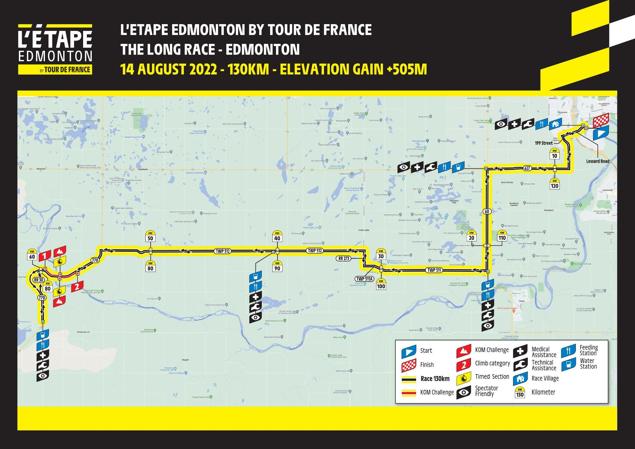
Long Route
13
Click below for the GPX File:
GPX
Notes:
change to long route;

Slide 15
Medium Route
14
Click below for the GPX File:
GPX
Notes:
medium route

Slide 16
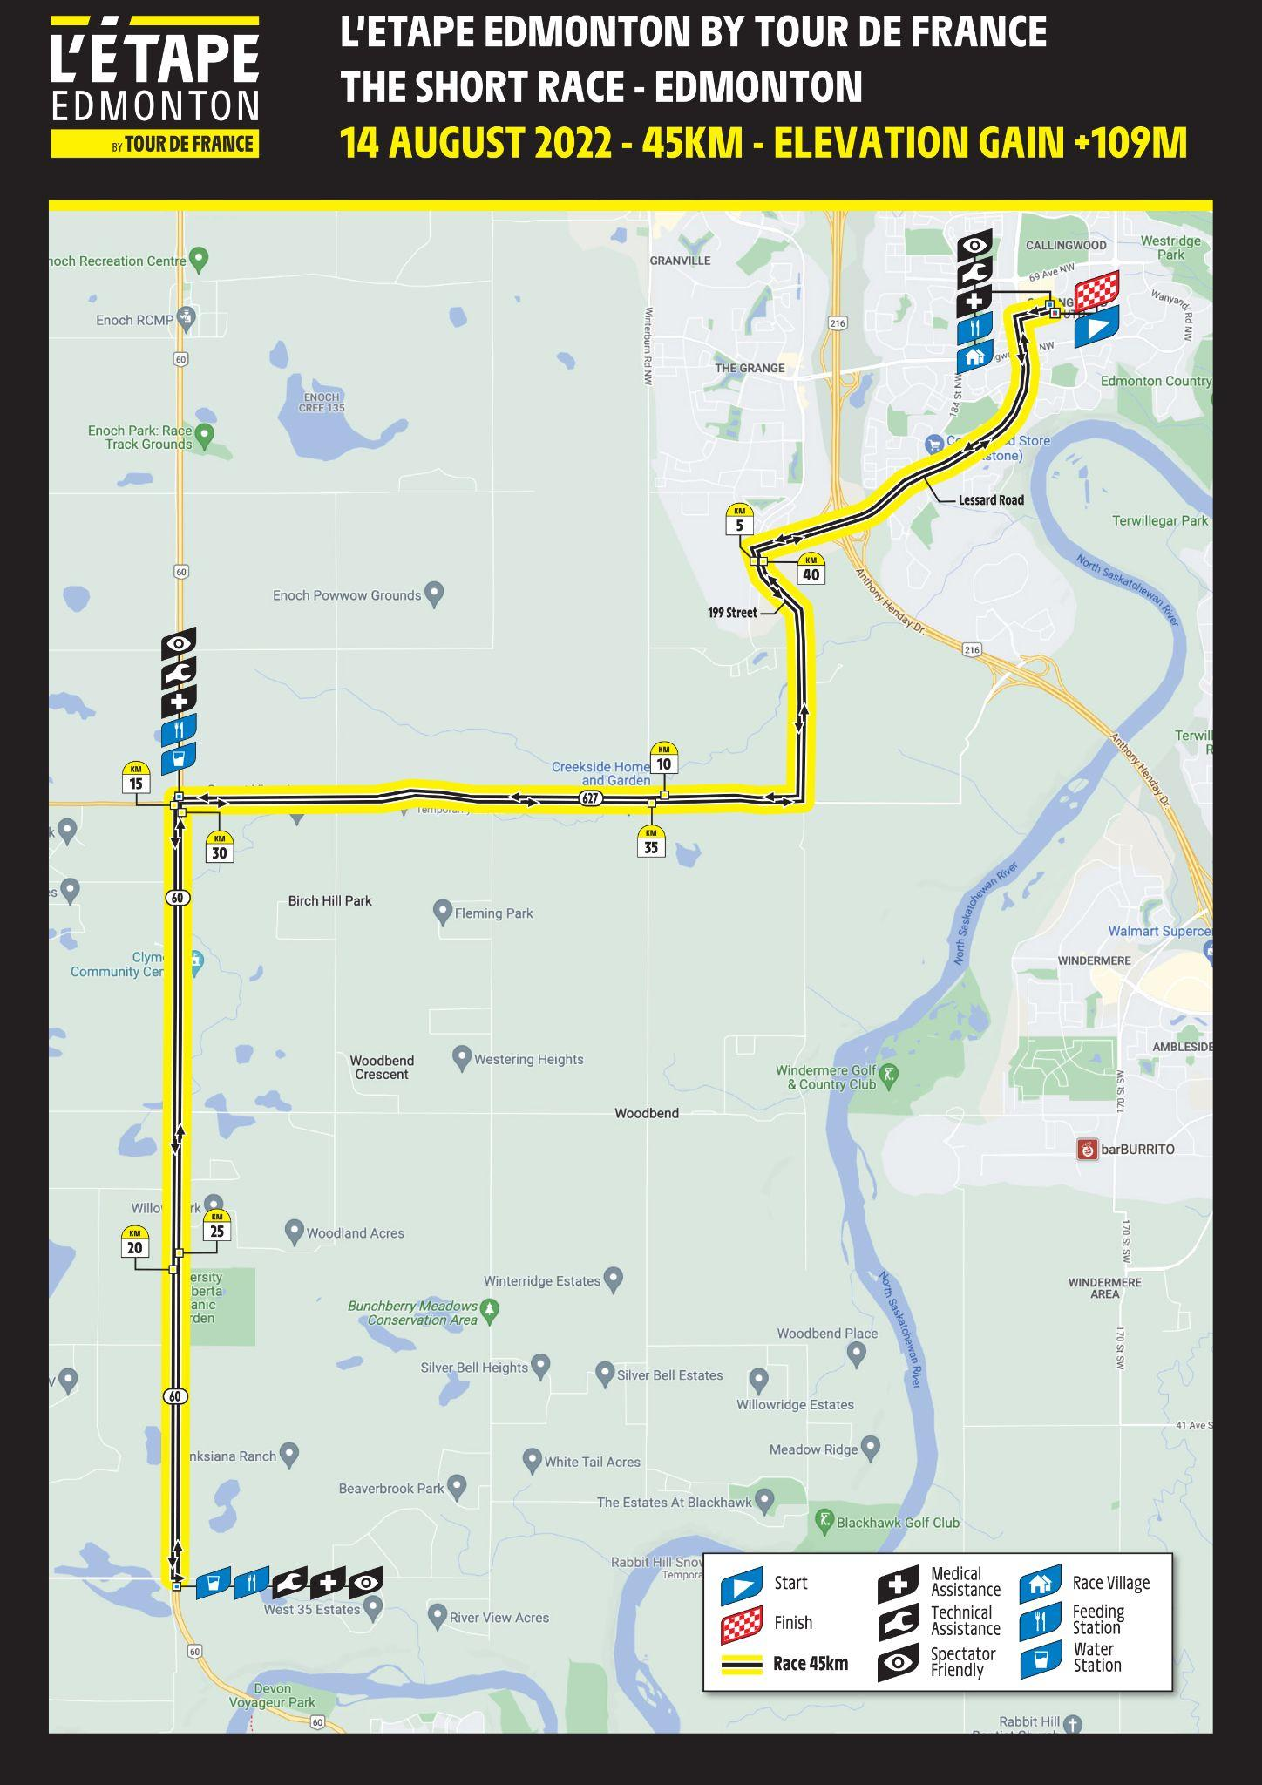
Short Route
15
Click below for the GPX File:
GPX

Slide 17
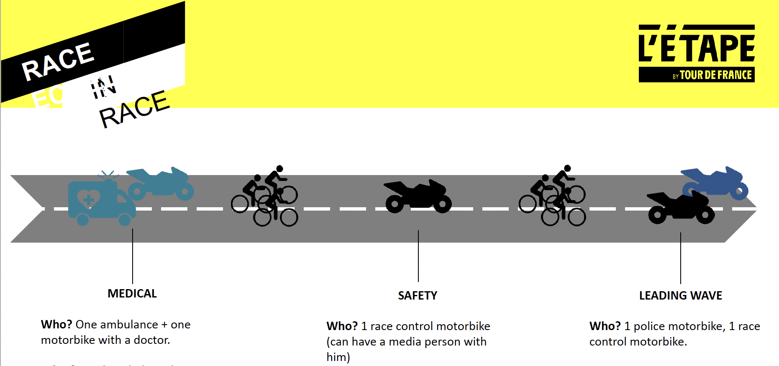
16
Safety Vehicles on Course
Course Markings
Know where to go. The course will be well marked with colored arrows specific to your race distance.
Pink for the Long route
Yellow for the Medium route
Green for the Short route

Slide 18
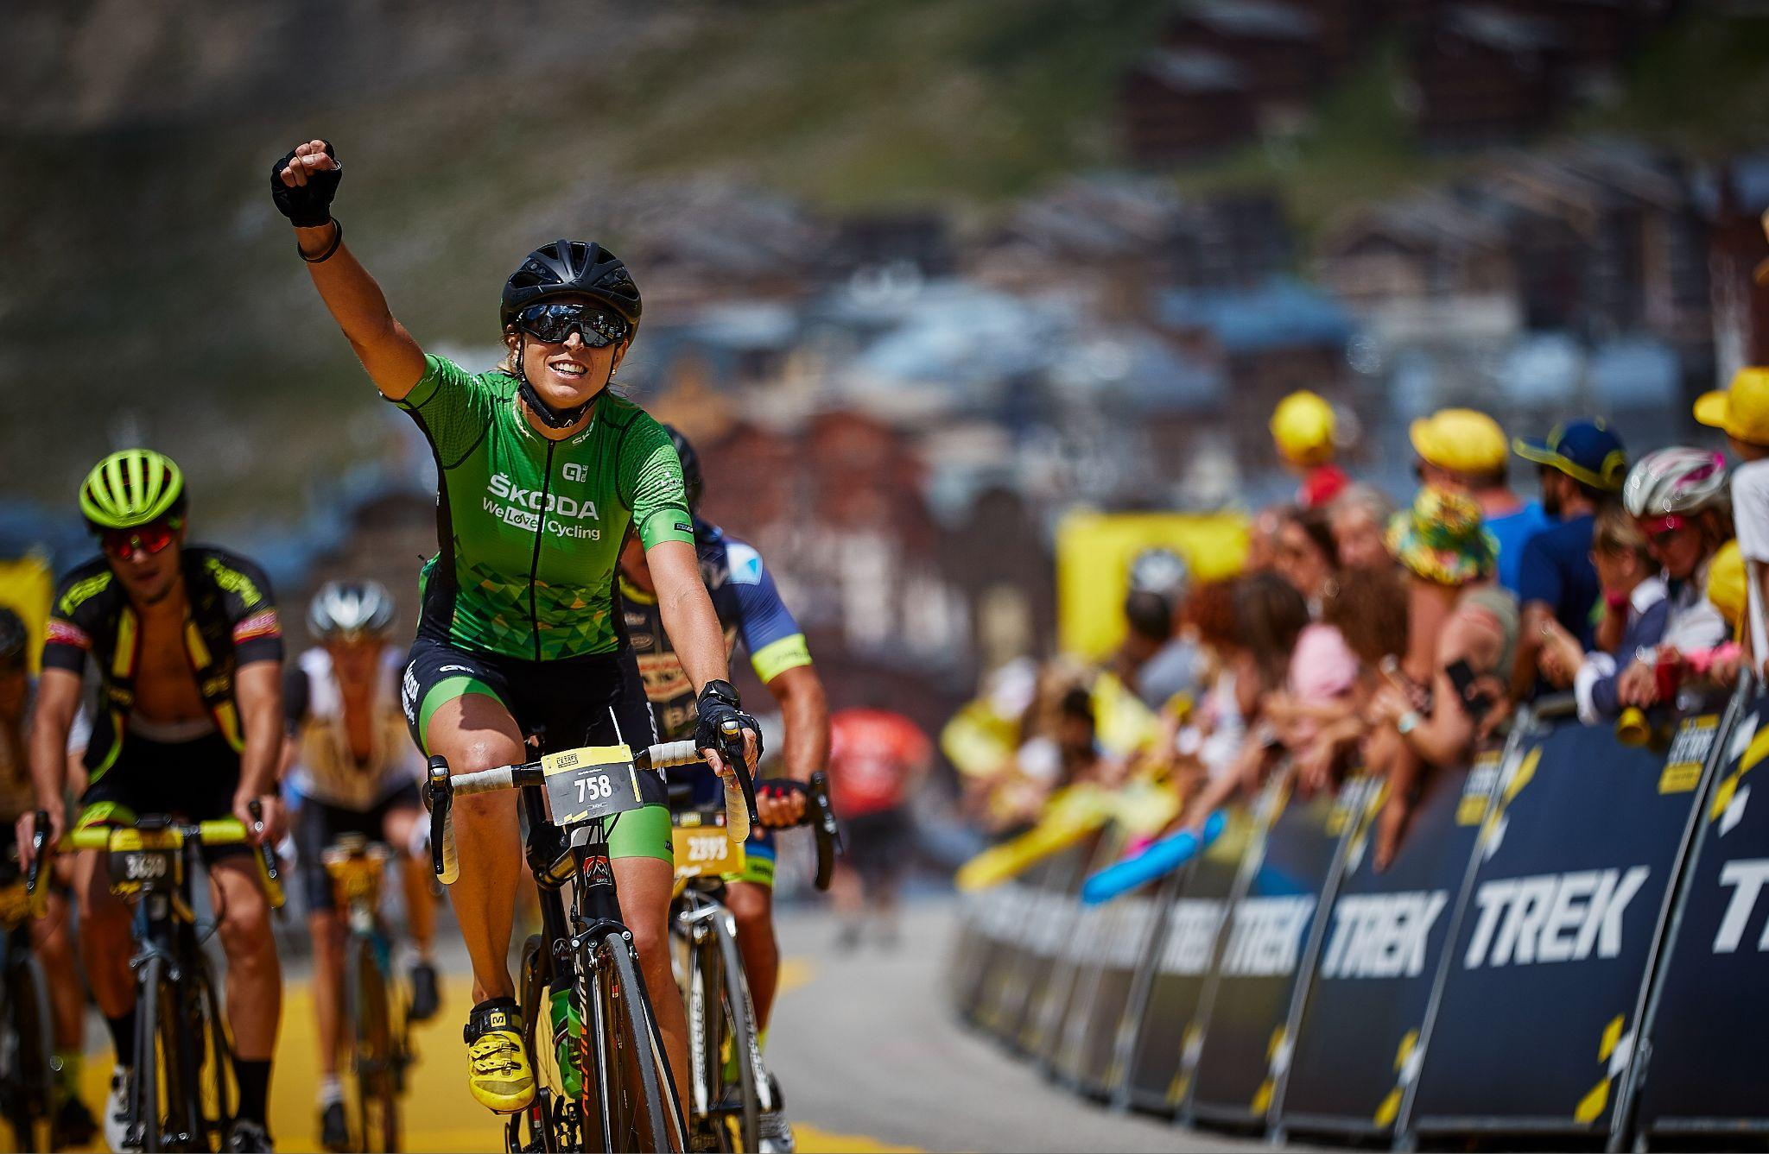
17
Awards & Prizes
Prizes for top finishers
Overall winners: The top overall individual female and male finishers will be presented with the iconic yellow jerseys and Tissot Watches.
Queen of the Mountain (QOM)/ King of the Mountain (KOM) winners: The top 3 overall male and female riders over the timed climb section will be awarded the polka-dot jersey.
Sprint winners: The top 3 overall male and female riders through the timed sprint section will be awarded the green jersey.
L’Étape by Tour de France Championship details
Age categories for awards
(For the Long, Medium, Short route) Age categories:
Under 20
20 to 29
30 to 39
40 to 49
50 to 59
60 to 69
70 to 79
80+
L’Étape Championship is an age group competition between all L’Étape by Tour de France riders. It takes place at the L’Étape du Tour event, in France in July, on the same roads as Tour de France, where the champions fight for the most coveted award in the world of cycling: the Yellow Jersey.
Riders come from all over the world to conquer L’Étape du Tour and the event sells out in minutes! However, a limited number of riders are automatically qualified for the Championship by finishing in the top 3 in the 130 km race at L’Étape Edmonton
All registrants for L’Étape Edmonton by Tour de France will receive a priority registration opportunity for L’Étape du Tour
Notes:
T

Slide 19
18
FinisherPix
Commemorate your race experience
Get your personal race photos with FinisherPix!
FinisherPix is the official photographer at L’Étape Edmonton by Tour de France. Your personal race photos will be available at www.finisherpix.com/e/5008 . Make sure your bike plate is facing front at all times and don't forget to smile when you cross the finish line. Have a great race!
· Ensure you have your race number facing front and visible at all times
· Look out for our FinisherPix photographers on course and SMILE
· Look up when you cross the finish line and smile BIG!
· If you pre-ordered your photos, you will receive a download-link by email as soon as photos are online!
· Upload a selfie at the bottom of your gallery to find more photos of you and to add it to your gallery.
Connect with us!
facebook.com/finisherpix | #finisherpix @finisherpix support@finisherpix.com | www.finisherpix.com
Your Best Photos
Notes:
Get updated info from Finisher Pix

Slide 20
19
Race Day
What should I bring on race day?
There will be food zones (Rest / Water Stops) to supply riders with nutrition, water and other necessities; however, we recommend you come with a few additions:
Helmet*
Photo ID*
Water bottles*
Additional food or sports nutrition
Sunscreen
Sunglasses
Spare clothing for weather
Flat repair kit
Mobile phone (charge it prior)
How do I get to the start line?
Access to the start line differs depending on where you are staying. Street parking options are available around the venue at Our Lady of the Prairies.
What time do I have to be at the start line?
The start time is 7:00am for the long and medium route. The short route will start at 7:15am.
The family ride will start at 7:30am. We recommend getting there at least five minutes before your start time.
Is there bike support on the course?
Yes, there will be both static and mobile bike support throughout the route.
Where can I find mechanical support?
We will have bike mechanics on site at the venue on race day.

Slide 21
20
FAQs
Is there a minimum age requirement to race?
Riders must be 16 to ride in the long/medium route.
Riders must be 14 to ride in the short route.
Riders must be 11 to ride in the Family Ride.
Riders must be 2 to 7 to ride in the Kids Ride.
What type of bikes are allowed at L’Étape Edmonton by Tour de France?
For the long route, only road bikes are permitted.
For the medium, road and gravel bikes with drops are allowed.
For the short route and Family Ride all bikes are allowed, including mountain bikes, gravel bikes, city bikes, cross bikes, and recumbents. Disc wheels, tri or aero bars are not permitted.
E-bikes are allowed in all but the Long km route ride, although any cyclist riding an e-bike won’t be ranked in a specific ranking to preserve fairness between participants.
What do I get with my Long, Medium, Short route registration?
Entry into race
Rider Registration Pack
Partially closed roads
Tour de France professional race conditions
Official L’Étape Edmonton t-shirt (Class Spéciale Riders will get a special edition race kit)
Official L’Étape Edmonton Swag
Backpack drop-off-and-pick-up service in the event village
Overall timing of your ride and Queen of the Mountain (QOM)/King of the Mountain (KOM) and Sprint section timing (Medium/Long Route)
Mechanical support in the village and on the racecourse
Medical assistance in the village and on the racecourse
Food Zones and Drink/Energy Zones at key locations on the course
Meal at the finish
Finisher medal
Where will the race take place?
The start/finish of the race will start at Our Lady of the Prairies The course will head west into the prairies and edge of the city, featuring a climbing challenge before heading back into Edmonton.
Will roads be closed?
Roads will be partially closed as riders will never be on an open road with vehicle traffic.
Notes:
link location

Slide 22
21
FAQs
Is the course timed?
The Long route and Medium route are timed events. The Short route, Family and Kids Rides are fun, non-timed events.
Do I need to wear a helmet?
Yes, all participants in L’Étape Edmonton must wear a helmet or they will be denied entry into the starting corral.
Can someone pick my packet up for me?
Unfortunately, due to liability issues, we can not allow anyone other than the person registered to pick up their race packet.
Water Stations
Short- 45 km Route
There will be one water station on this route including: Water, Electrolytes, Granola Bars.
We will have Water Stops on the race course.
A Water Stop is intended for riders to stop quickly or ride through and grab and replenish food and fluids as needed.
Each station will also include bike racks and washrooms.
Medium- 80 km Route
There will be three water stations on this route including: Water, Electrolytes, Granola bars.
Long- 130 km Route
There will be four stations on this route including: Water, Electrolytes, Granola bars.

Slide 23
22
Race Rules
Equipment:
Helmets must be worn and done up at all times.
For the Long route, only road bikes are permitted.
For the Medium, road and gravel bikes with drops are allowed.
For the Short and Family Ride all bikes are allowed, including mountain bikes, gravel bikes, city bikes, cross bikes, and recumbents. Disc wheels, tri or aero bars are not permitted.
E-bikes are allowed in all but the Long km route-mile ride, although any cyclist riding an e-bike won’t be ranked in a specific ranking to preserve fairness between participants.
Rules:
Expo & Team Area Rules: No Alcohol can be brought into the Festival Area. No coolers will be allowed in the expo area but coolers are permitted in the team area.
From the start to the finish of this event that uses the public highway, all participants will be expected to adhere to all briefings/information given in communications shared in advance of the event, briefings given on the day (which may supersede previous information if there have been any changes), and also to the Human Race cycling code, which includes the following:
Unless otherwise or expressly stated, the roads should always be considered as open to traffic (even if road signs suggest they may be shut) and you must ride accordingly as local access traffic may still use closed roads. Please obey all Highway Code rules and road regulations at all times.
NOTE: We reserve the right to terminate participation on health and safety grounds. This includes, but is not limited to, the re-direction or closure of sections of the route due to events outside our control, rider route progress, or in the event of severe weather conditions.

Slide 24
23
Race Rules (continued)
Code of Conduct:
You are requested to ride at a maximum 2 abreast at any time. Single file riding is mandatory when double white line systems are in operation on the roads.
Unless required during a safe overtaking procedure you should not cross the centre line whilst riding, and should make sure, particularly on descents, that you slow down sufficiently to be able to make a turn onto a side road without having to cross onto the ‘wrong’ side of the road.
Obey all directions from police, traffic control personnel or course workers. Riders MUST give way to emergency vehicles. Where the route has a delineated lane closure (e.g. cones), crossing into the non-delineated lane is strictly prohibited.
Look for obstacles, ride safely and predictably. Don’t swerve and weave, keep your head up, and ride in single file when possible. Please be aware of and exercise good road riding etiquette.
Riders will be assigned to a start corral based on the anticipated average speed provided at registration. Riders will not be allowed to move forward into a faster corral, but will be allowed to move into a slower corral.
Please always remain aware of your fellow participants and all other road users (including motor vehicles, other cyclists, horse riders and pedestrians) and ensure you always leave sufficient space / give way where required.
Please always indicate & signal your intention to stop or change direction, including at junctions.
Please also take note of any specific event signage which has been erected for the event as this will be in place for your safety and to warn you of what is approaching– HOWEVER these will not and cannot highlight every risk and so you must remain alert & maintain an awareness of your surroundings at all times.
You should remain in control and ride according to your ability as well as the road conditions / environment. So think and look ahead to look out for any potential obstacles / risks coming up. This may include hidden dips and obstacles / hazards around corners – if you cannot see a good way along the road ahead of you or around a corner then slow down accordingly so you can respond / react if necessary.
Please do not pass through any red traffic lights without using extreme caution, if directed please slow down as requested. Similarly keep a keen lookout at pedestrian crossings to those wishing to use them.
Please look out for and observe all Highways signage relating to descents, bends, general road regulations, cattle guards and other hazards.
Please note that we reserve the right to terminate your participation if you fail to comply with any of the above, or are seen to be riding dangerously.
Cut Off Times: For course management and road safety, a cut off time will be established for the Long route. Riders outside of this time will be re-routed to the medium course, your distance will be changed automatically to the medium km ride and your time will reflect your finish time for the Medium km distance. There is no outside support allowed for the entirety of the ride.
The event organizers reserve the right to refuse entry into the event if any of the above rules are violated by a participant.

Slide 25
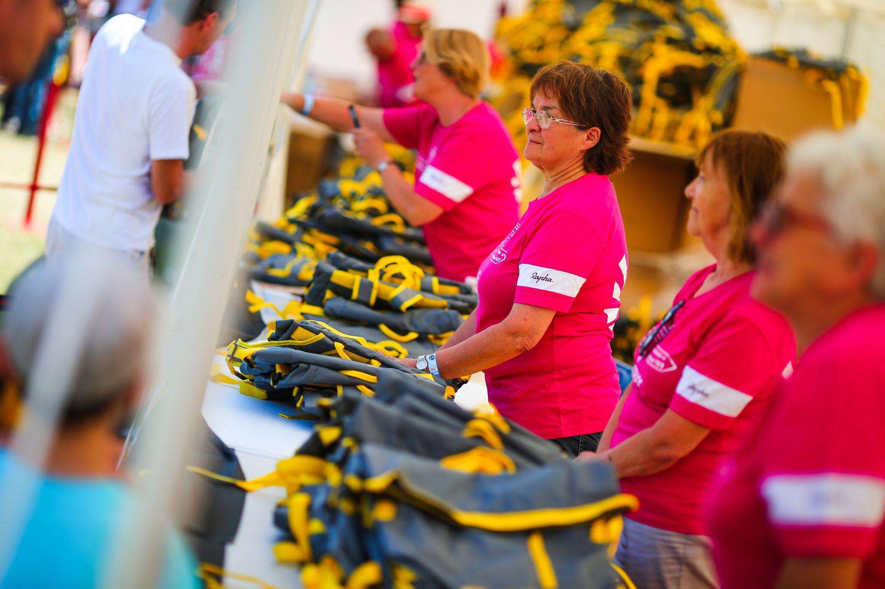
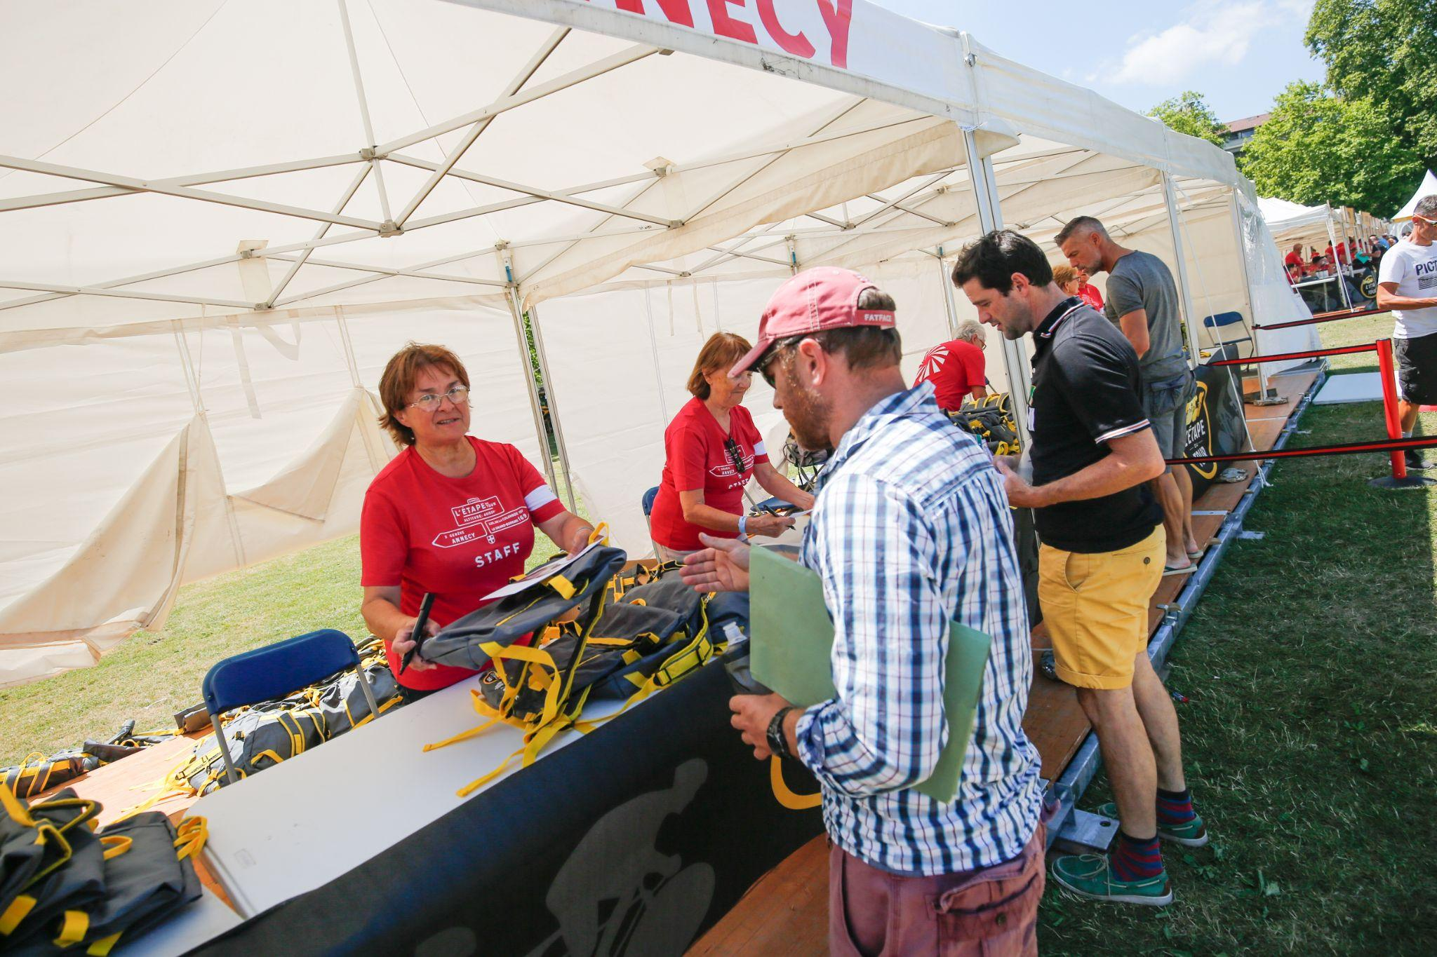
Volunteer
24
BE A PART OF THE ACTION!
Volunteers play a crucial role in hosting major events like L’Etape. Join us in making this a world class event by signing up to be a part of our volunteer team.
Sign up here!
We have a great range of volunteer opportunities available. Here are some great reasons to join our volunteer team:
-Meet new people
-Help cyclists achieve their goals
-Enjoy the energy of a great outdoor event in YOUR city
-Be a part of the excitement the L’Étape race experience offers
Contact Mandy Costache, Volunteer Director at mandy@mbevents.ca

Slide 26
25
Notes:
Explore Edmonton will be adding their information here

Slide 27
26
Notes:
Explore Edmonton will be adding their information here

Slide 28
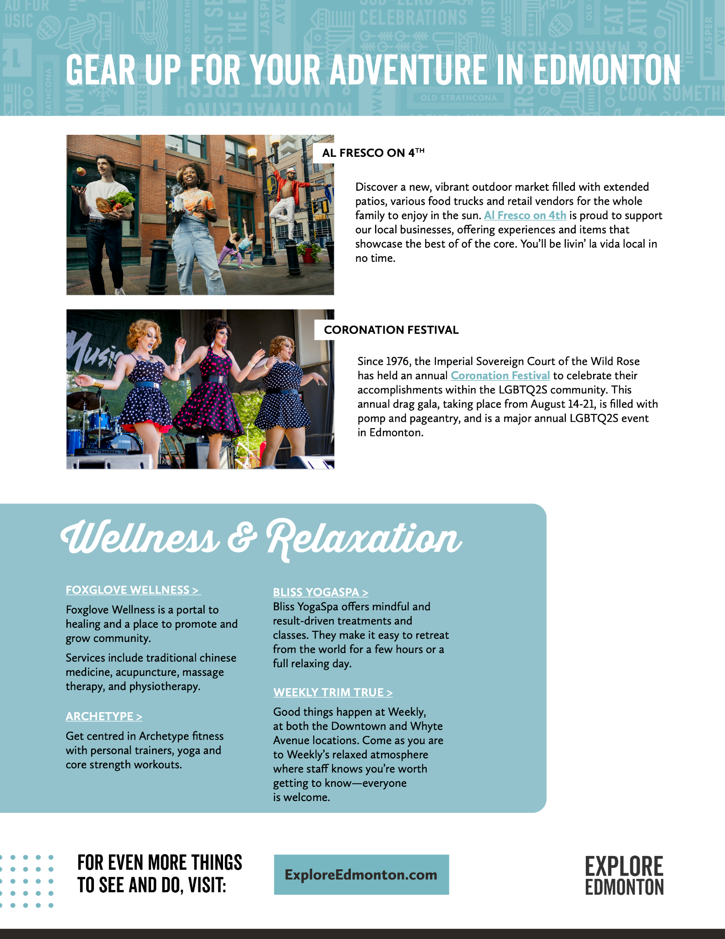
27
Notes:
Explore Edmonton will be adding their information here

Slide 29
29
Notes:
Explore Edmonton will be adding their information here

